Slide 2
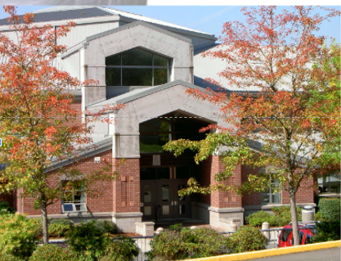
Our goal for today
Learn about ARHS
Start conversations about
classes for next year
Fill out registration (Google Sheet) talk to
parents/guardians and teachers

Slide 3
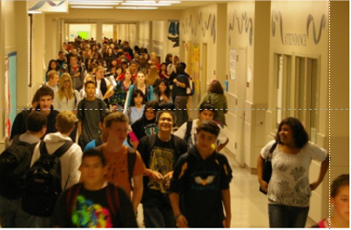
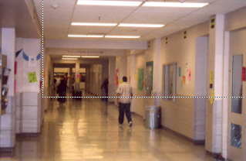
School Demographics
Total Staff: 132
-(Teachers, Counselors, Administrators, Support Staff, etc.)
Students
9th 430
10th 468
11th 492
12th 462

Slide 5
ARHS counselors are available (by using our online appointment request form) for a variety of reasons such as future planning, personal issues and classes.

Slide 6
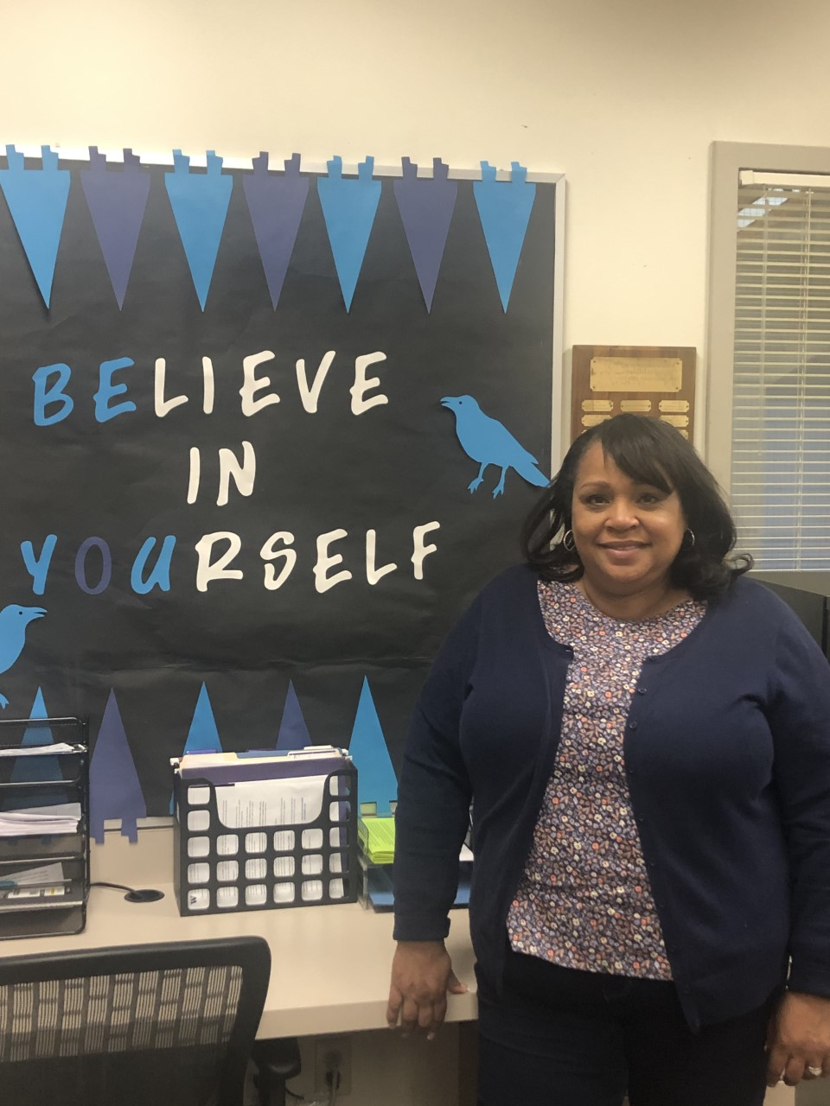
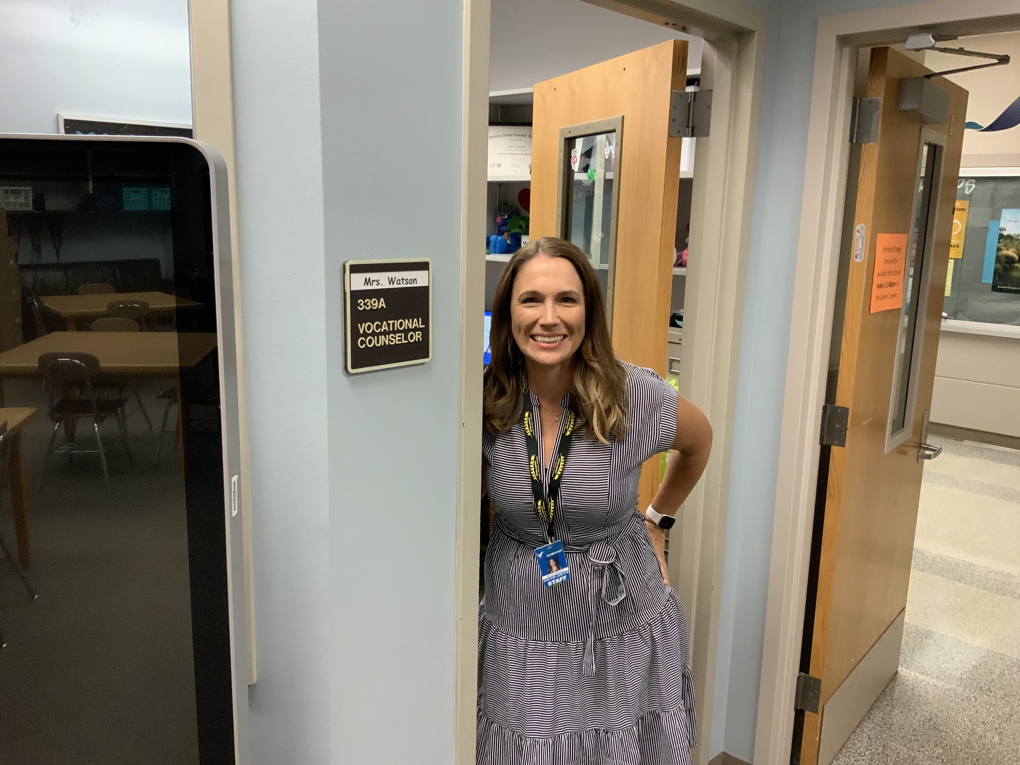
Career Center
Career Counselor
Mrs. Watson
helps students with scholarships and NCAA clearinghouse registration.
Go in and check out our resources and vocational testing when you are at Riverside
Lots of helpful information!
Mrs. Brank, our Career Center Assistant can also help you sign up for colleges presentations…

Slide 7
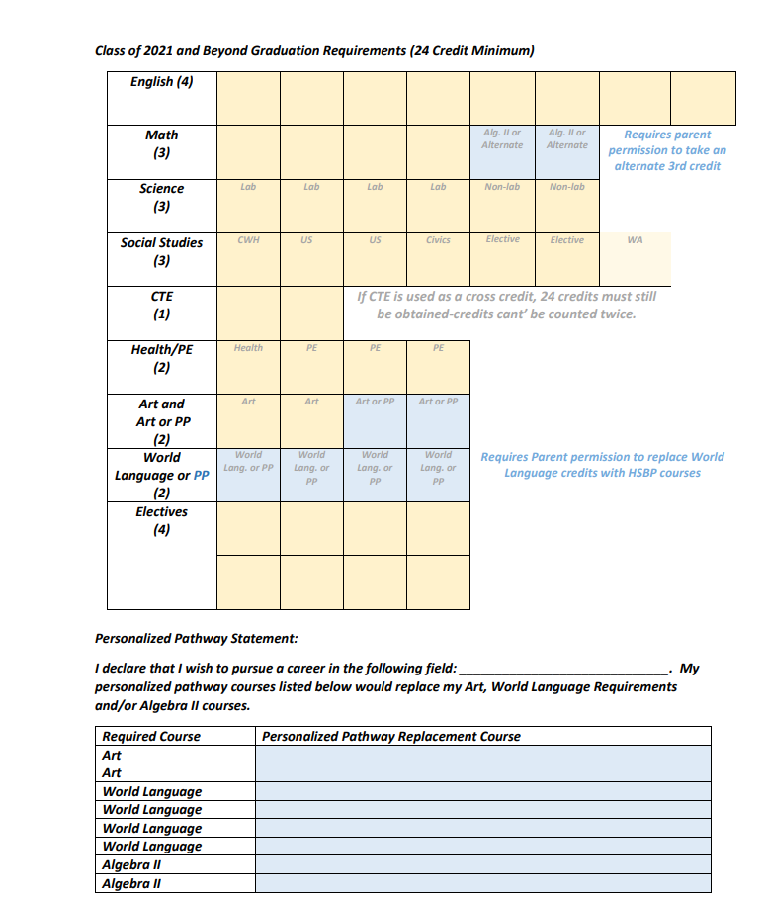
Box Page

Slide 8
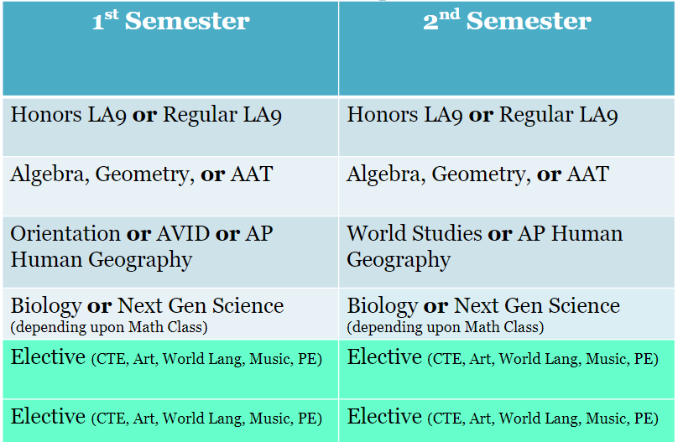
9th Grade Requirements

Slide 9
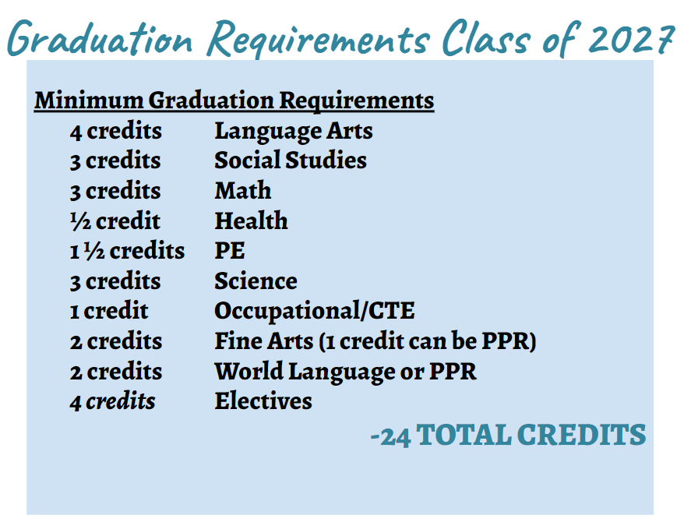
Graduation Requirements Class of 2027

Slide 10
State Testing Requirements Class of 2027
ELA – Language Arts
ELA – Math
WCAS – Science
*Requirements subject to change as a result of Legislative decisions

Slide 11
Advice from Counselors
Take the most rigorous classes you can (it looks good to colleges when you challenge yourself)
Maintain highest grades possible (transcript)
Get involved (sports/clubs)
Develop clear goals for your future
Begin networking with your teachers, counselors, coaches, etc…

Slide 12
Freedom and Responsibility
More independence with choosing classes
Choosing career path
Personal choices- Peers, work habits
Special events, Dances
Clubs/Activities
Sports
Tech Prep classes
Running Start

Slide 13
Specifically Athletics:
Athletics at Auburn Riverside seeks to develop young athletes of integrity, competitive passion and good sportsmanship. We look forward to seeing you in the stands and cheering on our favorite team.
We participate in the NPSL 3A League (Olympic Division)
Competitors: AHS, AMHS, Kent Meridian, Kentlake, Thomas Jefferson and Todd Beamer
GO RAVENS!!

Slide 14
Are you eligible?
To be eligible incoming freshman need:
A valid annual athletic registration form
Current Physical dated after June 1st (This physical will be good for two years)
Academic eligibility passing 5 of 6 classes
Student Body ASB card
Resident of Auburn School District

Slide 15
Sports Offered
Fall—begins in August.
Girls’ Swim/Dive, Football, Volleyball, Girls’ Soccer, Cross Country, Boys’ Tennis, Boys’ Water Polo, Golf
Winter—begins in Nov.
Boys’ Swim/Dive, Gymnastics, Basketball, Wrestling
Spring—begins late Feb./March.
Baseball, Fastpitch, Track/Field, Girls’ Water Polo, Girls’ Tennis, Boys’ Soccer, Boys 'and Girls’ Lacrosse
Dance Team and Cheerleading tryouts for next year

Slide 16
Registration for 9th grade
Please discuss with parents and teachers on class placement
Mt. Baker
North Tapps (Do not forget enroll into the Auburn School District!)
Olympic
We are so excited for you to become a
RAVEN!

